Slide 1
Module 4

Slide 2
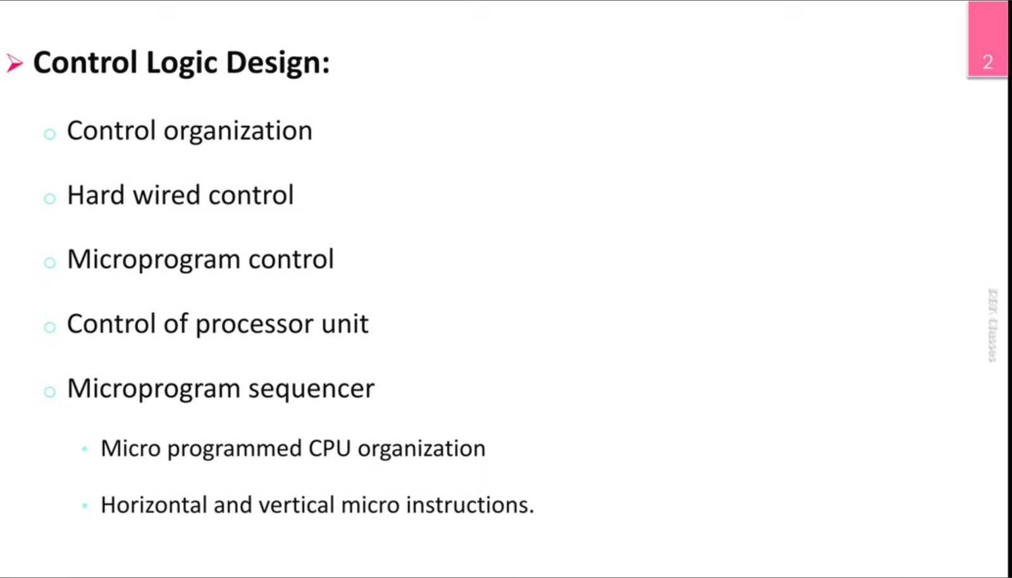

Slide 3
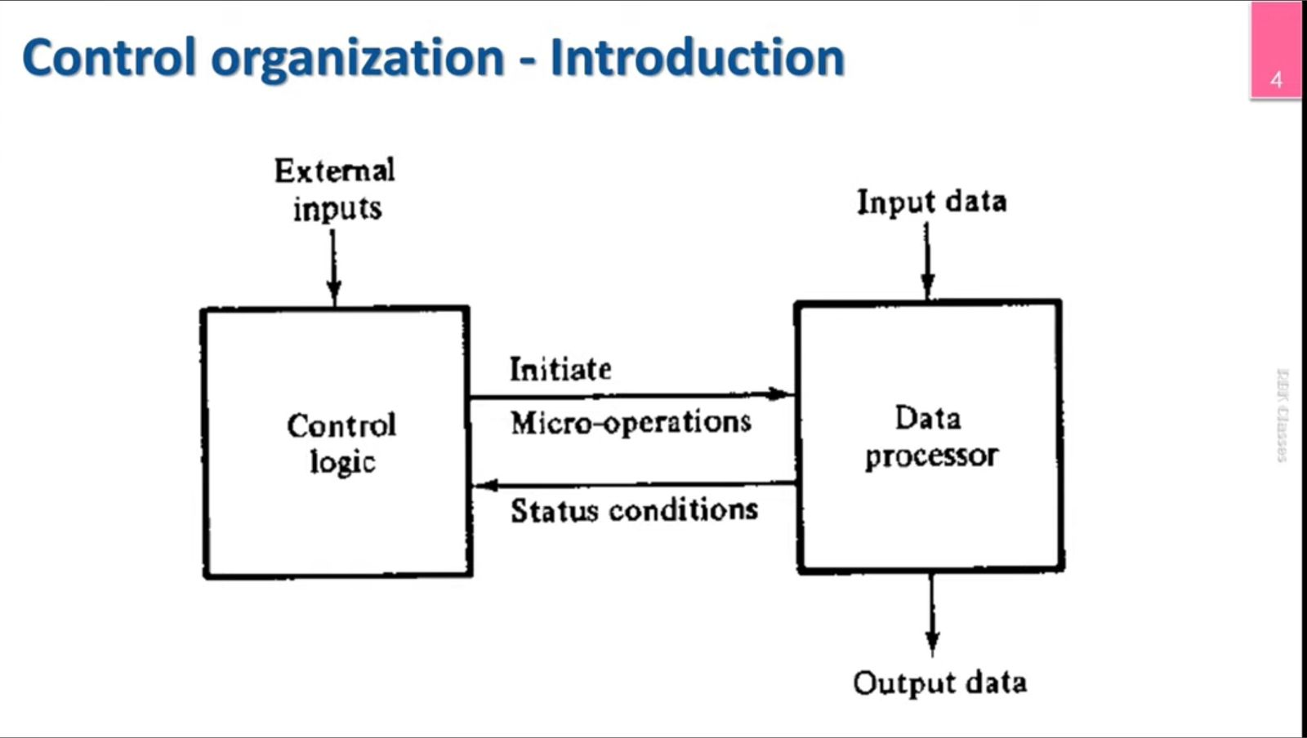

Slide 4
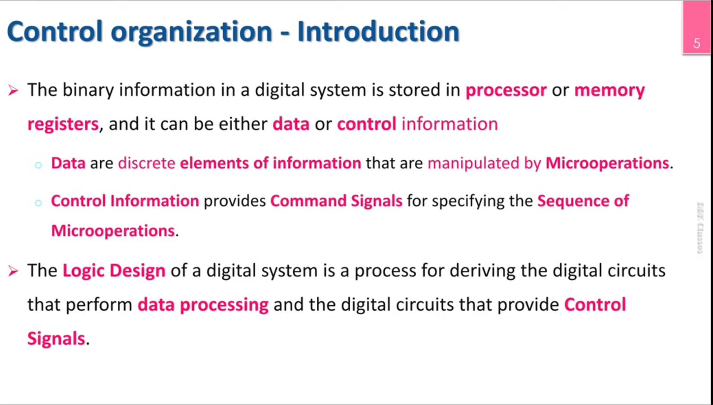

Slide 5
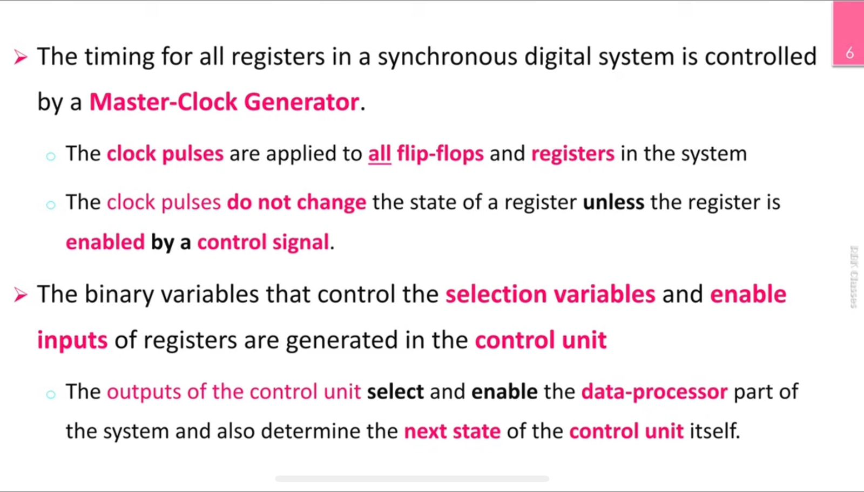

Slide 6
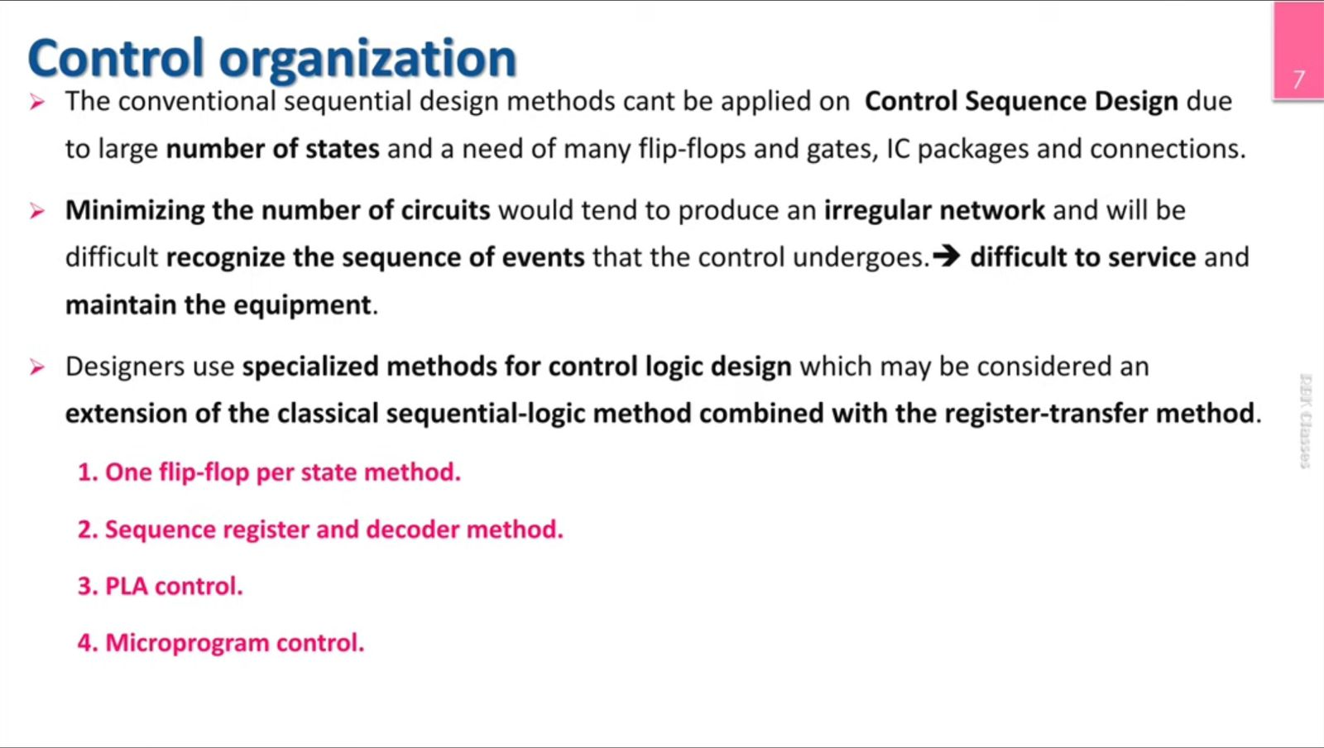

Slide 7
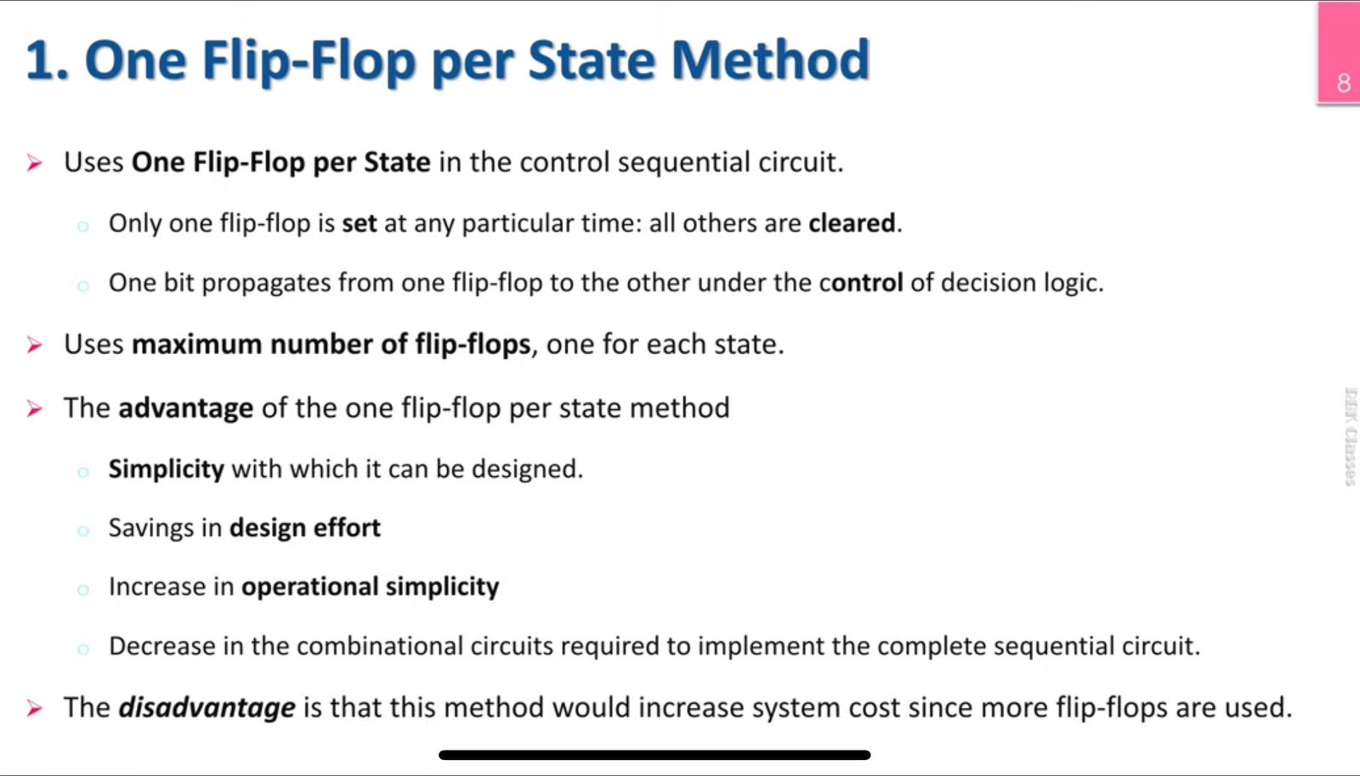

Slide 8
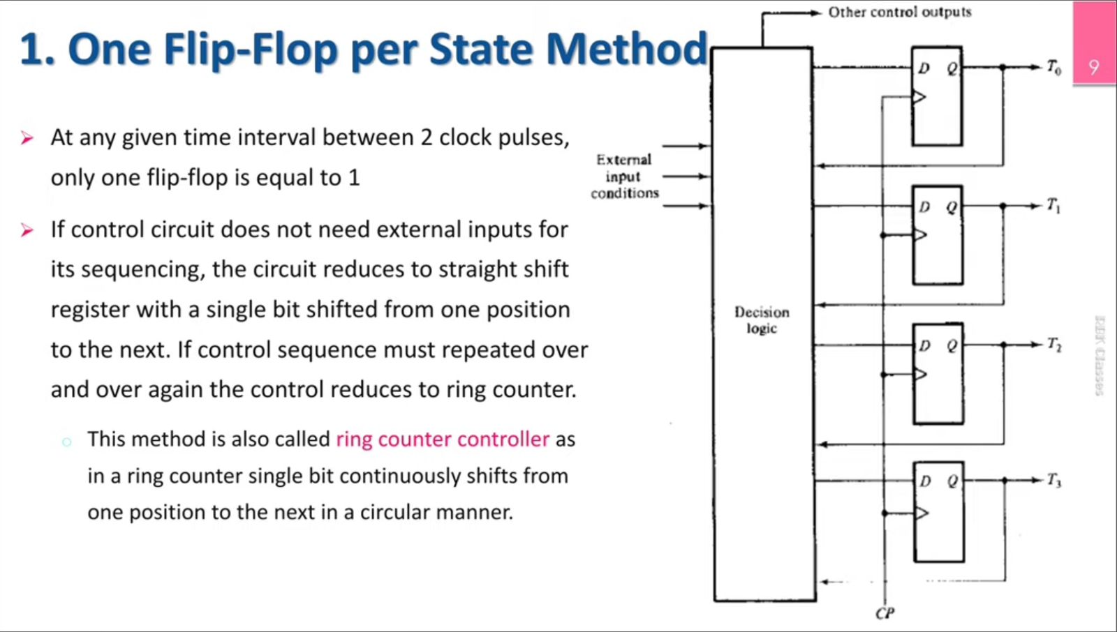

Slide 9
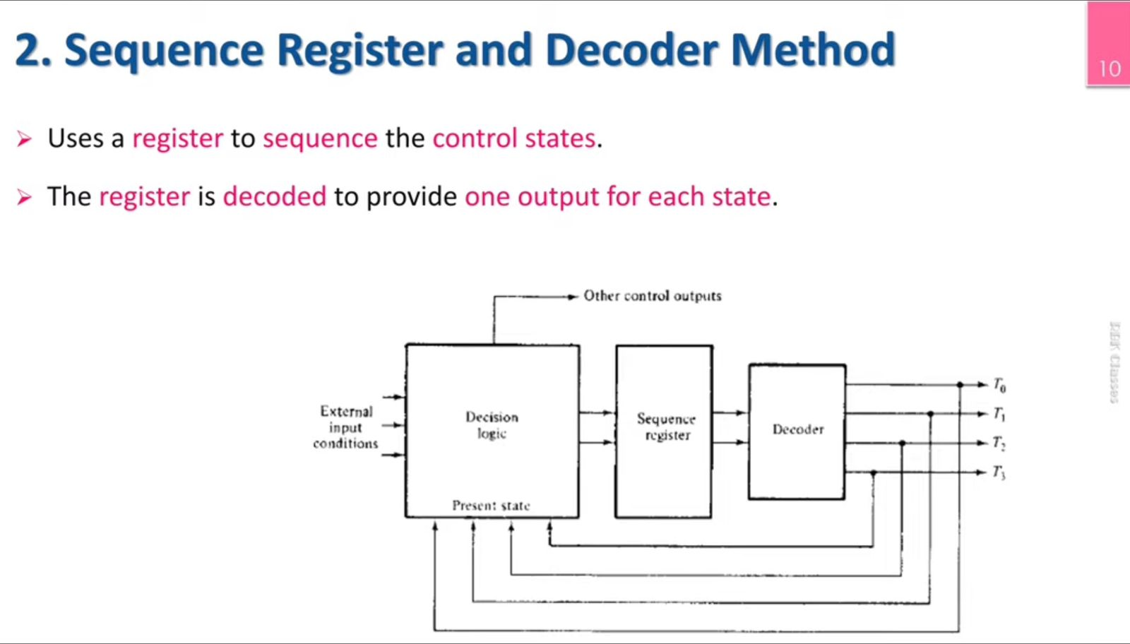

Slide 10
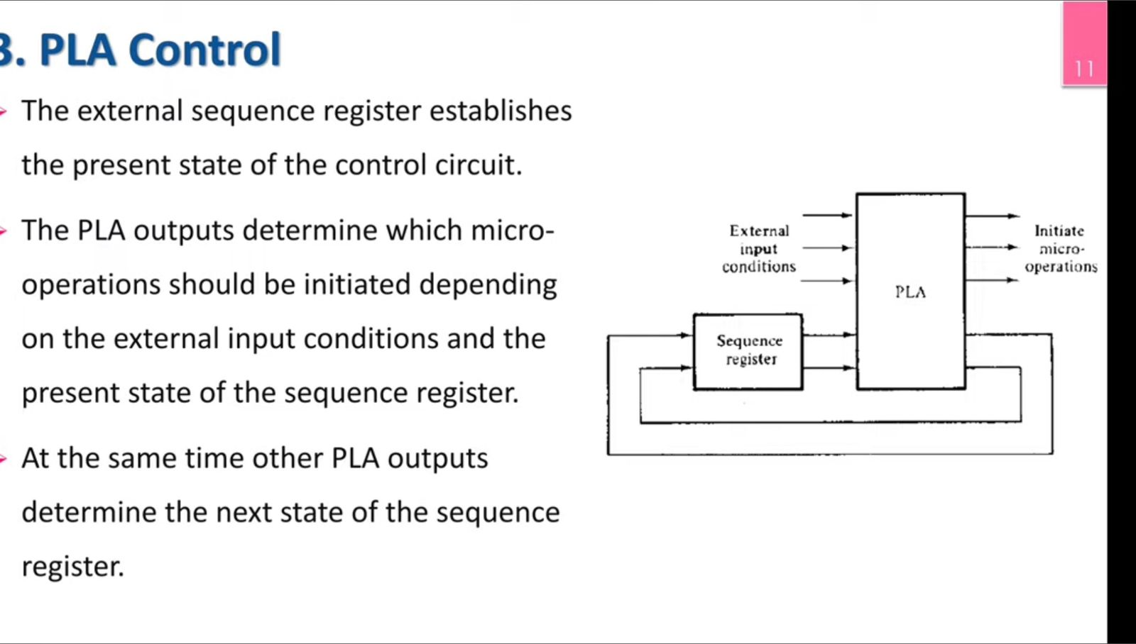
Programmable Logic Array- PLA

Slide 11
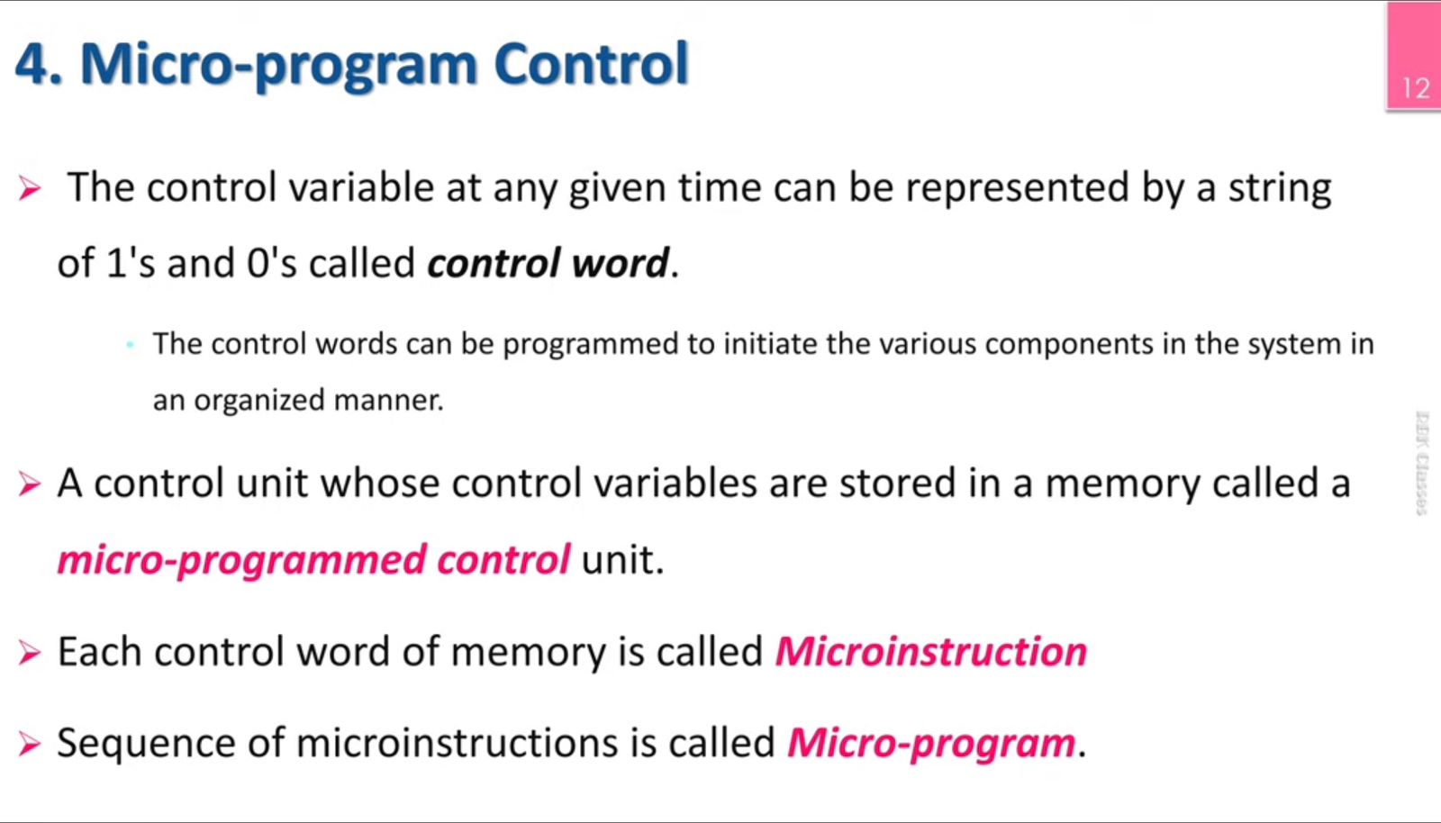

Slide 12
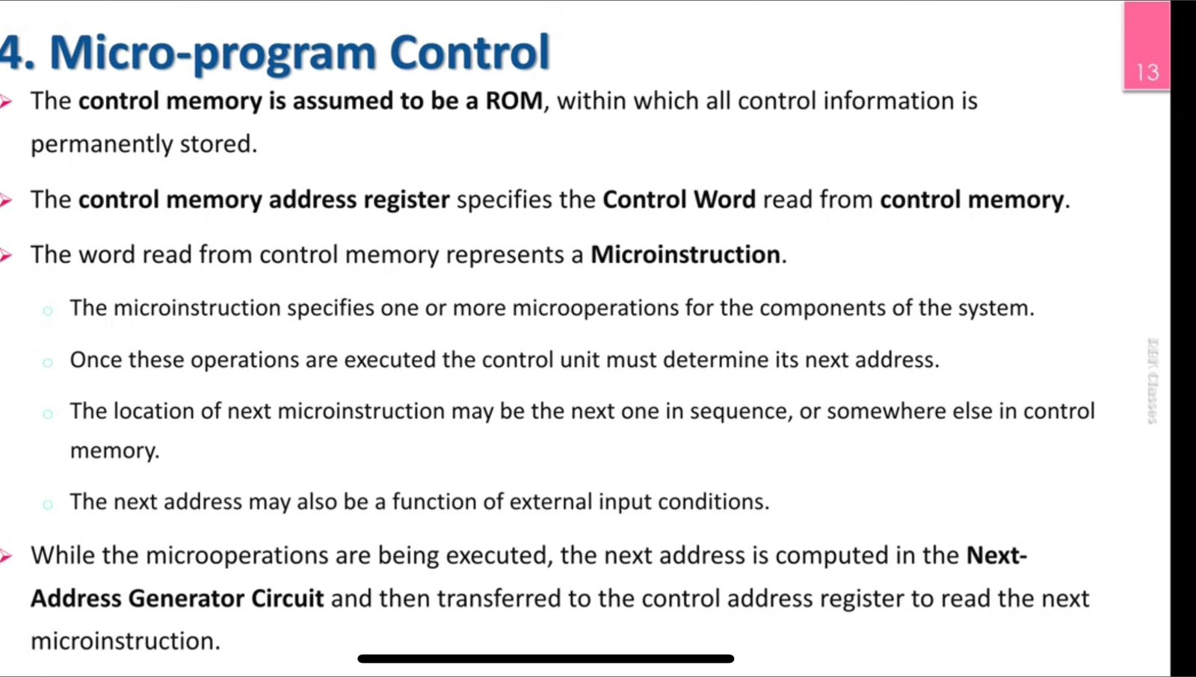

Slide 13
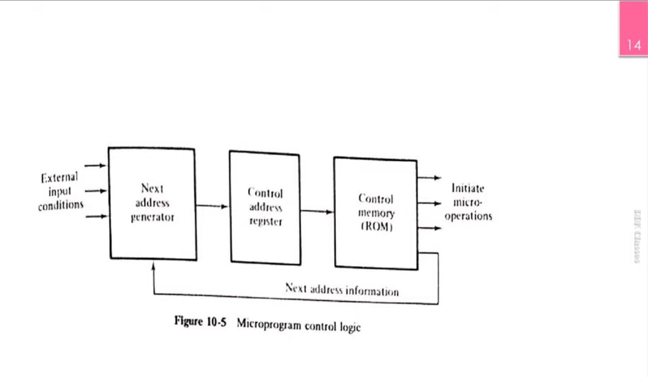

Slide 14
HARD WIRED CONTROL
The control hardware can be viewed as a state machine that changes from one state to another in every clock cycle, depending on the contents of the instruction register, the condition codes and the external inputs.
The outputs of the state machine are the control signals. The sequence of the operation carried out by this machine is determined by the wiring of the logic elements and hence named as “hardwired”.

Slide 15
Control logic derived in this section is a hardwired control of the one flip-flop per state method. The design of hardwired control is carried out in 5 consecutive steps
1. The problem is stated
2. An initial equipment configuration is assumed
3. An algorithm is formulated
4. The data processor part is specified
5. The control logic is designed

Slide 16
Statement of the problem
The problem here is to implement with hardware the addition and subtraction of two fixed-point binary numbers represented in sign-magnitude form. Complement arithmetic may be used, provided the final result is in sign-magnitude form.
The addition of two numbers stored in registers of finite length may result in a sum that exceeds the storage capacity of the register by one bit. The extra bit is said to cause an overflow. The circuit must provide a flip-flop for storing a possible overflow bit.

Slide 17
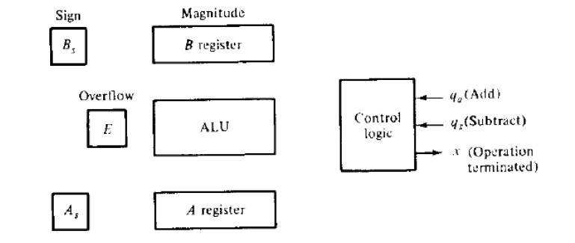
Equipment Configuration
The two signed binary numbers to be added or subtracted contain n bits. The magnitudes of the numbers contain k = n - 1 bits and are stored in registers A and B. The sign bits are stored in flip-flops As and Bs.

Slide 18
Figure shows the registers and associated equipment. The ALU performs the arithmetic operations and the 1-bit register E serves as the overflow flip-flop. The output carry from the ALU is transferred to E.
It is assumed that the two numbers and their signs have been transferred to their respective registers and that the result of the operation is to be available in registers A and As. Two input signals in the control specify the add (qa) and subtract (qs) operations. Output variable x indicates the end of the operation.
The control logic communicates with the outside environment through the input and output variables. Control recognizes input signal qa or qs and provides the required operation. Upon completion of the operation, control informs the external environment with output x that the sum or difference is in registers A and A, and that the overflow bit is in E.

Slide 19
Derivation of the Algorithm
Designate the magnitude of the two numbers by A and B.
When the numbers are added or subtracted algebraically, there are eight different conditions to consider, depending on the sign of the numbers and the operation performed. The eight conditions may be expressed in a compact form as follows:
(±𝐴) ± (±𝐵)

Slide 20
If the arithmetic operation specified is subtraction, we change the sign of B and add. This is evident from the relations:
(±𝐴) − (+𝐵) = (±𝐴) + (−𝐵)
(± 𝐴) − (−𝐵) = (±𝐴) + (+𝐵)
This reduces the number of possible conditions to four, namely:
(±𝐴) + (±𝐵)
The four possible combination are
When the signs of A and B are the same:
(+𝐴) + (+ 𝐵) = +(𝐴 + 𝐵)
(−𝐴) + (− 𝐵) = −(𝐴 + 𝐵)

Slide 21
When the signs of A and B are not the same
(+ 𝐴) + (− 𝐵) = +(𝐴−𝐵) [ if(A>B) ]
−(𝐵−𝐴) [ if(B>A) ]
(−𝐴) + (+𝐵) = −(𝐴−𝐵) [ if(A>B) ]
+(𝐵−𝐴) [ if(B>A) ]

Slide 22
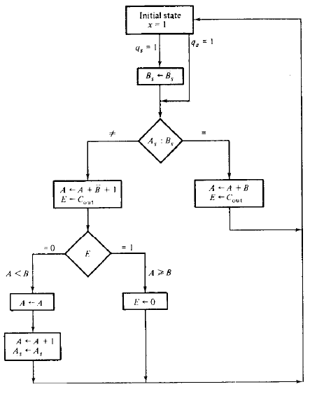

Slide 23
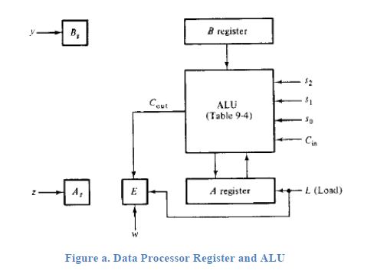
Data Processor Specification
Figure (a) shows the data-processor with the required control variables. This ALU has four selection variables, as shown in the diagram. The variable Is loads the output of the ALU into register A and also the output carry into E. Variables y, z. and w complement B, and A, and clear E, respectively.

Slide 24
The block diagram of the control logic is shown in figure (b). The control receives five inputs: two from the external environment and three from the data-processor. To simplify the design, we define a new variable
S = As⊕ Bs
This variable gives the result of the comparison between the two sign bits. The exclusive- OR operation is equal to 1 if the two signs are not the same, and it is equal to 0 if the signs are both positive or both negative.
The control provides an output x for the external circuit. It also selects the operations in the ALU through the four selection variables S2, S1, S0, and Cin. The other four outputs go to registers in the data-processor as specified in the diagram

Slide 25
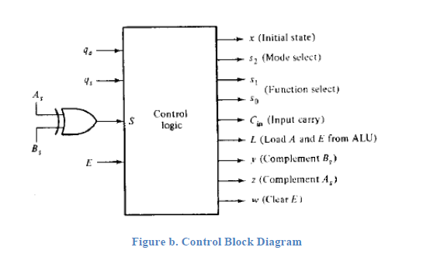

Slide 26
Control State Diagram
The design of a hard-wired control is a sequential-logic problem. As such, it may be convenient to formulate the state diagram of the sequential control. The function boxes in a flowchart may be considered as states of the sequential circuit, and the decision boxes as next-state conditions.
The micro-operations that must be executed at a given state are specified within the function box. The conditions for the next state transition are specified inside the decision box or in the directed lines between two function boxes.
Consequently, different designers may produce different state diagrams for the same flowchart, and each may be a correct representation of the system. The control state diagram and the corresponding register-transfer operations are derived in below figure.

Slide 27
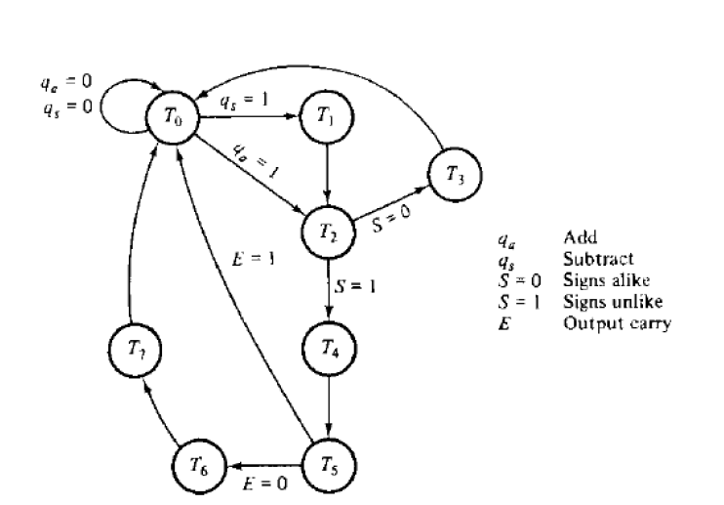

Slide 28
We start by assigning an initial state, To, to the sequential controller. We then determine the transition to other states T1, T2, T3, and so on.
For each state, we determine the micro-operations that must be initiated by the control circuit. The figure below shows the sequence of register transfers.

Slide 29
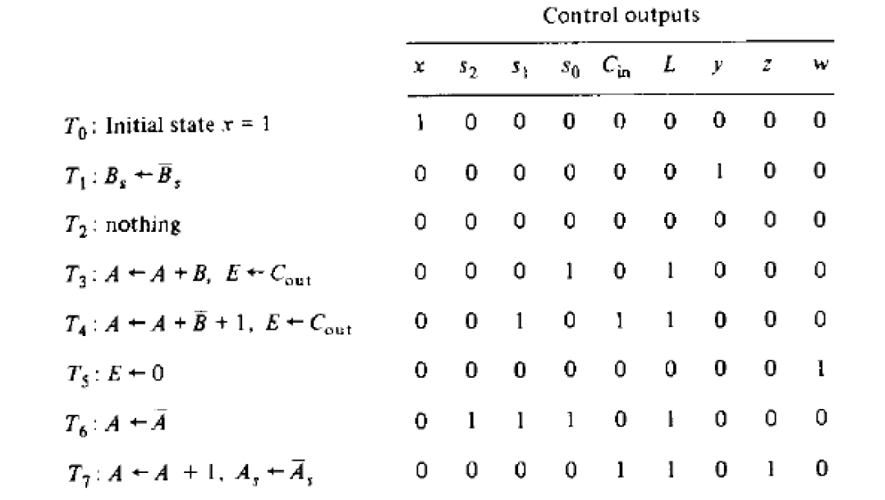

Slide 30
Design of Hardwired Control
The control can be designed using the classical sequential-logic procedure. This procedure requires a state table with eight states, four inputs, and nine outputs. The sequential circuit to be derived from such a state table will not be easy to obtain because of the large number of variables.
The circuit obtained by using this method may have a minimum number of gates, but it will have an irregular pattern and will be difficult to analyze if a malfunction occurs. These difficulties are removed if the control is designed by the one flip-flop per state method.

Slide 31
A control organization that uses one flip-flop per state has the convenient characteristic that the circuit can be derived directly from the state diagram by inspection. No state or excitation tables are needed if D flip-flops are employed.
Remember that the next state of a D flip-flop is a function of the D input and is independent of the present state. Since the method requires one flip-flop for each state, we choose eight D flip-flops and label their outputs T0, T1, T2, . . , T7. The condition for setting a given flip-flop is specified in the state diagram.

Slide 32
For example, flip-flop T2 is set with the next clock pulse if T1= I or if T0 = 1 and qa = 1. This condition can be defined with the Boolean function:
DT2 = qaT0 + T1
where DT2 designates the D input of flip-flop T2.If there is more than one directed line going into a state, all conditions must be ORed.
Using this procedure for the other flip-flops, we obtain the input functions given in table below.

Slide 33
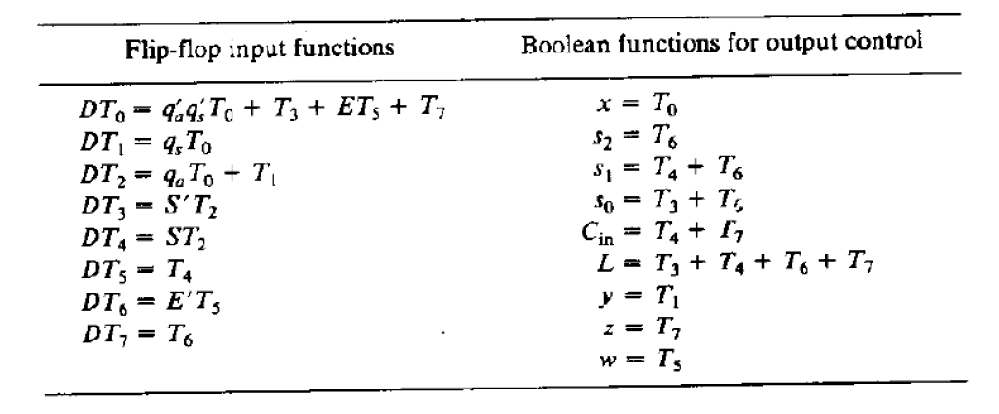

Slide 34
Initially, flip-flop T0 is set and all others are cleared. At any given time, only one D input is in the 1 state while all others are maintained at 0. The next clock pulse sets the flip-flop whose D input is 1 and clears all others.
The circuit for the control logic is not drawn but can be easily obtained from the Boolean functions in table. The circuit can be constructed with eight D flip-flops, seven AND gates, six OR gates, and four inverters. Note that five control outputs are taken directly from the flip-flop outputs

Slide 35
MICRO-PROGRAM CONTROL
In a micro-program control, the control variables that initiate micro-operations are stored in memory.
The control memory is usually a ROM, since the control sequence is permanent and needs no alteration. The control variables stored in memory are read one at a time to initiate the sequence of micro-operations for the system.
Each micro operation is associated with a specific set of control lines which, when activated, causes that micro operation to take place.

Slide 36
Since the number of instructions and control lines is often in the hundreds, the complexity of hardwired control unit is very high.
The hardwired control unit is relatively inflexible because it is difficult to change the design, if one wishes to correct design error or modify the instruction set
The micro programmed control unit consists of following components.

Slide 37
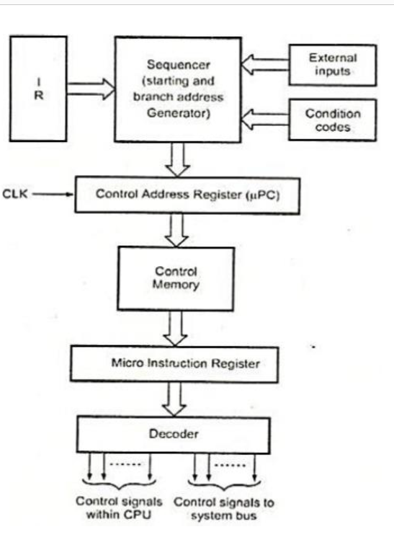

Slide 38
Control memory:
In micro programmed control, the micro programs for all instructions are stored in the control memory (CM).
The control signals to be activated at any time are specified by a microinstruction, which is fetched from Control memory (CM).
Control address register
The control address register holds the address of the next microinstruction to be read. When address is available in control address register, the sequencer issues READ command to the control memory.
Microinstruction register
After issue of READ command, the word from the addressed location is read into the microinstruction register.
Now the content of the micro instruction register generates control signals and next address information for the sequencer.

Slide 39
Micro-program sequencer
A sequence of one or more micro operations designed to control specific operation, such as addition, multiplication is called a micro program.
The sequencer loads a new address into the control address register based on the next address information

Slide 40
Advantages of Micro programmed control
It simplifies the design of control unit. Thus it is both, cheaper and less error prone implement.
Control functions are implemented in software rather than hardware.
The design process is orderly and systematic
More flexible, can be changed to accommodate new system specifications or to correct the design errors quickly and cheaply.
Complex function such as floating point arithmetic can be realized efficiently.
Disadvantages
A micro programmed control unit is somewhat slower than the hardwired control unit, because time is required to access the microinstructions from CM
The flexibility is achieved at some extra hardware cost due to the control memory and its access circuitry.

Slide 41
Microinstructions
The words stored in a control memory are microinstructions, and each microinstruction specifies one or more micro-operations for the components in the system.
Example: Control Sequence for instruction Add (R3), R1:
1. PCout, MARin, Read, Select4, Add, Zin
2. Zout, PCin, Yin, Wait for the MFC
3. MDRout, IRin
4. R3out, MARin, Read
5. R1out, Yin, Wait for MFC
6. MDRout, Select Y, Add, Zin
7. Zout, R1in, End
The microinstruction for the above control sequence can be expressed as follows

Slide 42
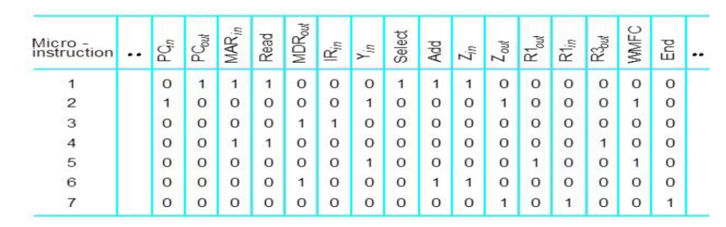

Slide 43
Once these micro-operations are executed, the control unit must determine its next address.
Therefore, a few bits of the microinstruction are used to control the generation of the address for the next microinstruction. Thus, a microinstruction contains bits for initiating micro-operations and bits that determine the next address for the control memory itself

Slide 44
Techniques of grouping of Control Signals
The grouping of control signal can be done either by using technique called
Vertical organization,
Horizontal organization.
Horizontal Micro-Instructions
The scheme of micro-instruction by assigning one bit position to each control signal is called horizontal micro-instructions.
Example: 011101001101001110
In a horizontal microinstruction every bit in the control field attaches to a controller. Horizontal microinstructions represent several micro-operations that are executed at the same time. However, in extreme cases, each horizontal microinstruction controls all the hardware resources of the system.

Slide 45
Vertical Micro-Instructions
We can reduce the length of the horizontal micro-instruction so easily by implementing another method known as vertical micro-instructions. In this case, Most signals are not needed simultaneously and many others are mutually exclusive
Example:

Slide 46
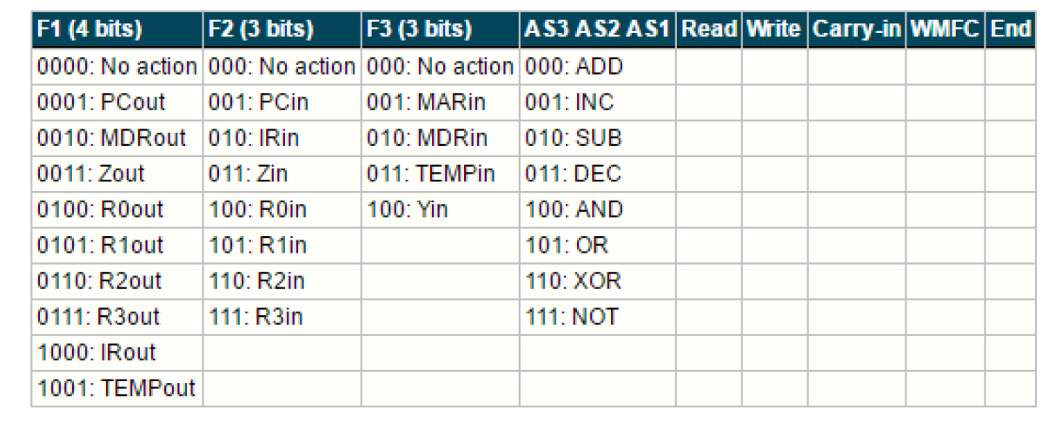

Slide 47
In a vertical microinstruction, a code is used for each action to be performed and the decoder translates this code into individual control signals. The vertical microinstruction resembles the conventional machine language format comprising one operation and a few operands. As opposed to horizontal microinstructions, the vertical microinstruction represents single micro-operations.
Advantage
Fewer bits are required in the microinstruction.
Disadvantage
Vertical approach results in slower operations speed.

Slide 48
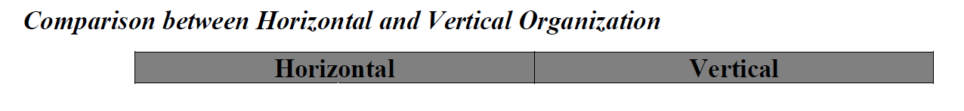
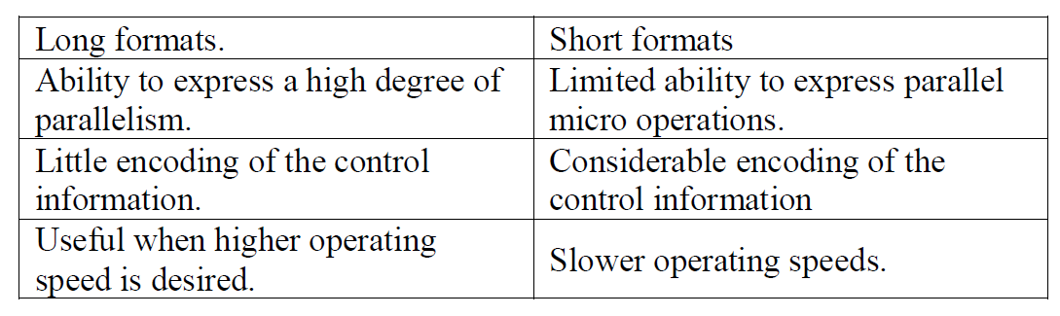

Slide 49
Micro-program Sequencer
Micro program sequencer is a control unit which does the tasks of Micro-program sequencing.
There are two important factors must be considered while designing the micro program sequencer.
o The size of the microinstruction
o The address generation time
Micro-program sequencer is attached to the control memory. It inspects certain bits in the microinstruction to determine the next address for control memory. A typical sequencer has the following address sequencing capabilities.

Slide 50
1. Increments the present address of control memory
2. Branches to an address which will be specified in the bits of microinstruction
3. Branches to a given address if a specified status bit is equal to 1.
4. Transfers control to a new address as specified by an external source
5. Has a facility for subroutines calls and returns.
The block diagram of Micro-program Sequencer is shown in the below figure. It consists of a multiplexer that selects an address from four sources and routes it into a control address register (CAR).

Slide 51
The output from CAR provides the address for control memory. The contents of CAR are incremented and applied to the multiplexer and to the stack register file.
The register selected in the stack is determined by stack pointer. Inputs (I0-I2) specify the operation for the sequencer and input T is the test point for a status bit. Initially the address register is cleared to zero and clock pulse synchronizes the loading into registers

Slide 52
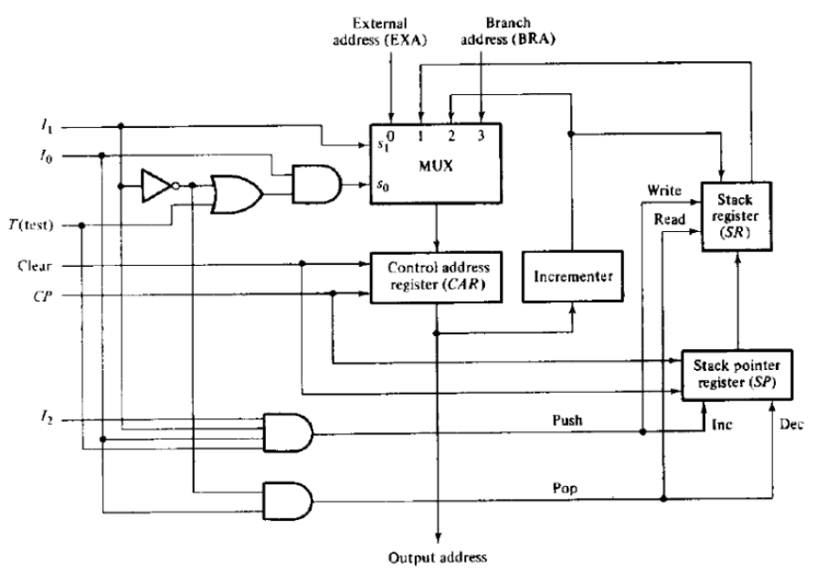

Slide 53
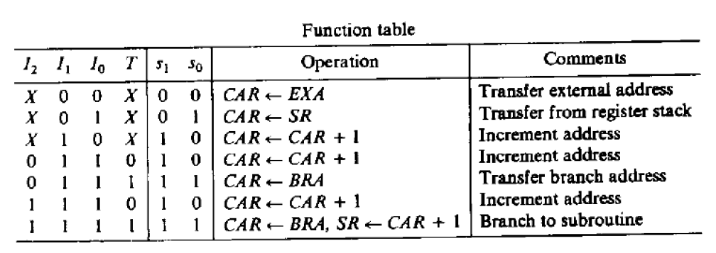

Slide 54
Micro-programmed CPU Organization
Digital computer consists of: Central Processing Unit(CPU), Memory unit and Input-output devices.
CPU can be divides into 2 distinct and interactive sections namely
-processing section: useful device for constructing the processor section of a CPU and
-control section: controlling the entire units of computer,
- micro-program sequencer: constructing a micro-program control of CPU

Slide 55
Micro-programmed computer
A computer CPU uses the micro-program sequencer. Micro-programmed computer consists of
1. Memory unit: Stores instructions and data supplied by the user through an input device
2. Two processor unit:
-Data processor: Manipulates data &
-Address processor: Manipulates the address information received from memory
3. A Micro-program sequencer
4. A control memory
5. Other digital functions

Slide 56
An instruction extracted from memory unit during fetch cycle goes into instruction register.
Code transformation constitutes a mapping function that is needed to convert the operation code bits of an instruction into a starting address for the control memory and is implemented with ROM or PLA.
Mapping concept provides flexibility for adding instructions or micro-operations for control memory as need arises. The address generated in code transformation mapping function is applied to the external address (EXA) input of the sequencing.

Slide 57
Micro-program control unit consists of
1. The sequencer: Generates next address
2. A control memory: Reads the next microinstruction while present microinstruction are being executed in the other units of the CPU and for storing microinstructions
3. A multiplexer: Selects one of the many status bits and applies to the T(test) input of the sequencer. One of the input of the multiplexer is always I to provide an unconditional branch operation
A pipeline register: speed up the control operation, Allows next address to be generated and the output of control memory to change while the control word in pipeline register initiates the micro-operations given by present microinstruction, It’s not always necessary.
The output of control memory can go directly to the control inputs of the various units in the CPU

Slide 58
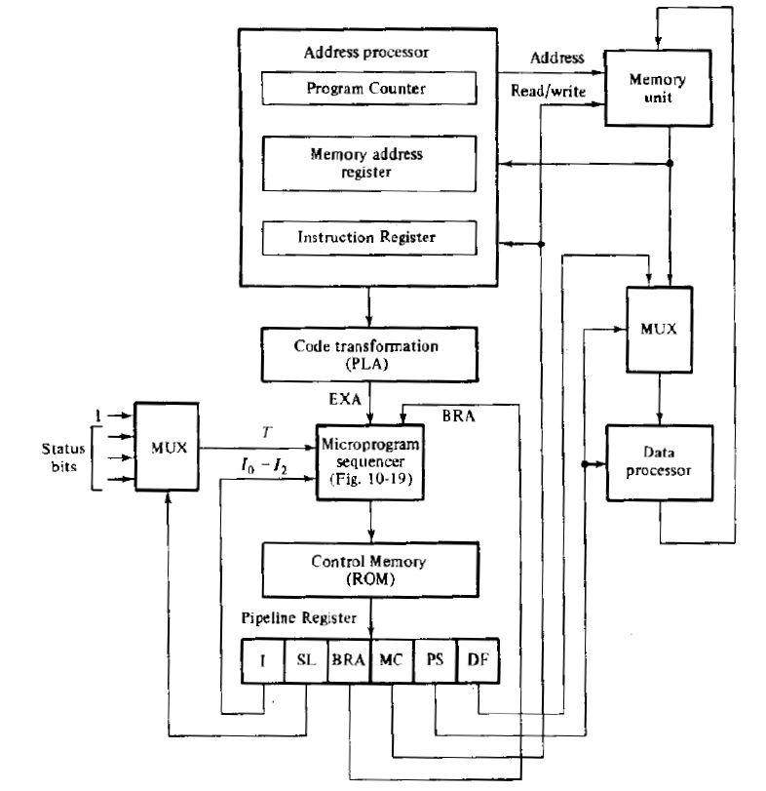

Slide 59
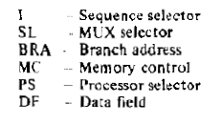

Slide 60
Microinstruction format contains six fields: First 3 fields(I,SL, BRA) provide information to the sequencer to determine the next address for control memory.
[I field (3 bits): Supplies input information for the sequencer, SL field: Selects a status bit for the multiplexer, BRA field: Address field of microinstruction and supplies a branch address (BRA) to the sequencer.]
The next 3 fields (MC, PS, DF) are for controlling micro-operations in the processor and the memory units
[Memory control (MC) field: Controls the address processor and the read and write operations in the memory unit. The processor select(PS) field: Controls the operations in the data processor unit. The data field(DF): Used to introduce constants into the processor]
Output from data field may be used to set up control registers and introduce data in processor registers.

Slide 61
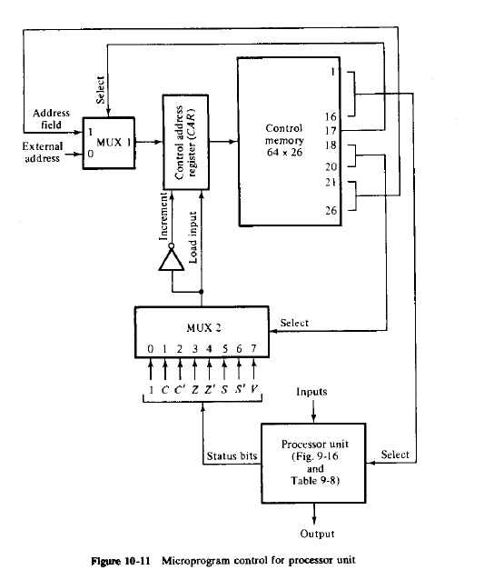
Control of Processor Unit

